Slide 1


OU-Hostel
Project Idea Presentation
Group No : K4

Slide 2
CONTENT
01.Group members.
02.Introduction to the project.
03.Project objectives.
04.Identified Functional Requirements.
05.Identified Non-Functional Requirements.
06.Proposed System Architecture Diagram.
07.Use case diagram.
08.Wireframes of UI design.
09.Progress of the project.
10.Trello Board Screenshot.
11.GIT Account.
12.Monthly Retrospective. 13.Project limitations and Problems encounter.

Slide 3
OUR TEAM
W.K.V.P Randunu (Leader) : S92069544
W.M.U.M.Wijerathna (UI/UX Designer) : S92085907
P.G.R.K.E. Peramuna (Quality Assurance) : S92083197
K.A.M.S.Kumarasinghe (Database Administrator) : S92081991

Slide 4
Introduction
University students, especially from remote areas, struggle to secure hostel accommodations due to the lack of an efficient management system. This results in confusion and inconvenience for both students and administrators.
Our project aims to develop a streamlined hostel booking system to provide real-time room availability, simplify the booking process, and improve communication.
This will enhance the overall experience for students and boost the efficiency of hostel management.

Slide 5
PROJECT OBJECTIVES
Our project aims to develop a comprehensive hostel booking system for university students and administrators.
Key features include real-time availability checks, an efficient booking platform, room management tools via an admin dashboard, automated notifications, an integrated payment gateway, and a feedback mechanism for continuous improvement.

Slide 6
FUNCTIONAL REQUIREMENTS
01. Login and Register To The System.
02. View Student Availability.
03. Select Hostel Room.
04. Register Student Details.
05. Make payments using payment gateway.

Slide 7
NON-FUNCTIONAL REQUIREMENTS
01. Expected Daily Users.
02. Page Loading Time.
03. Response Time.
04. Browser Version to be Supported.
05. Database Version to be Supported.

Slide 8
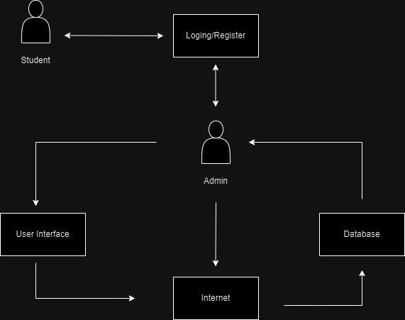
SYSTEM ARCHITECTURE DIAGRAM

Slide 9
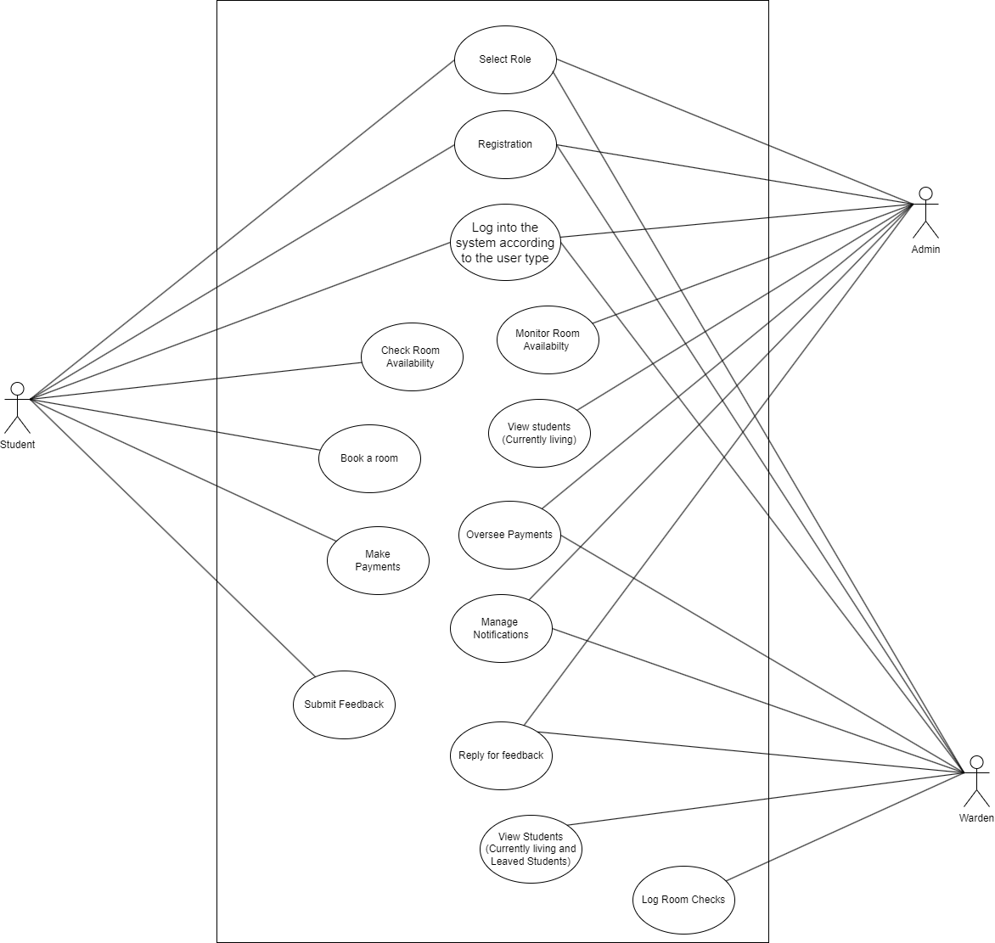
Use cases / user stories

Slide 10
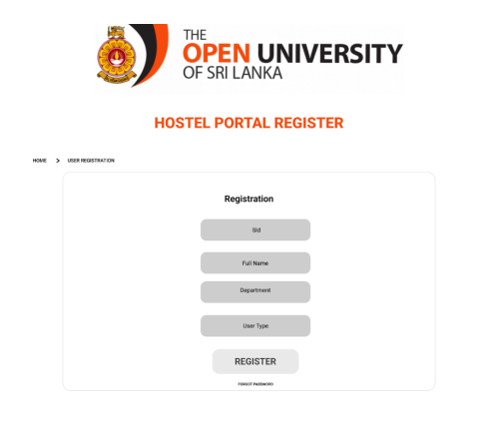
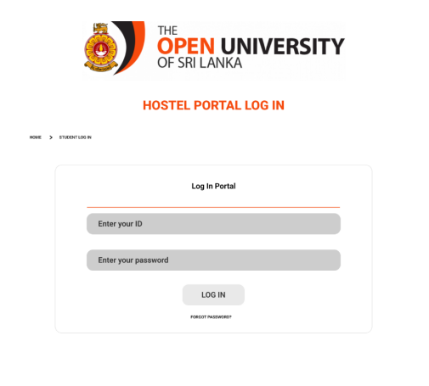
UI
Figma Link : https://www.figma.com/design/dkkAkOpxRXs4ydD5R4mcld/OU-HOSTEL-Management-System-(2)?node-id=0-1&node-type=canvas&t=bqHELxsvGj0UGdIQ-0

Slide 11
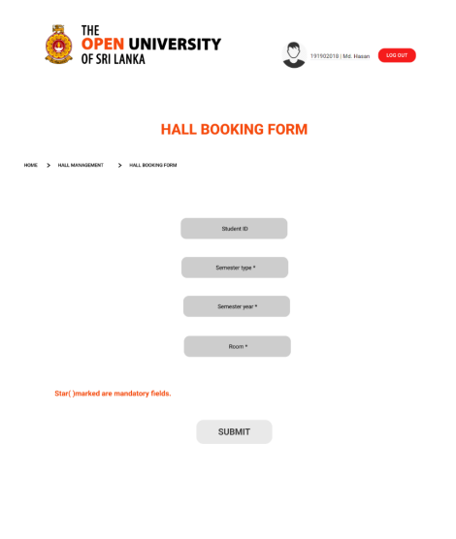
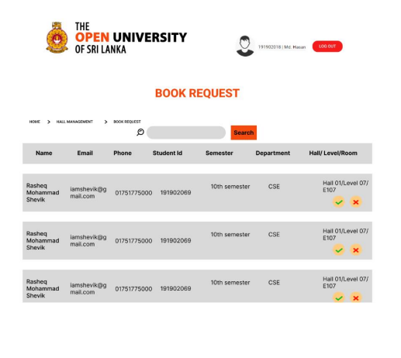

Slide 12
PROGRESS SUMMARY
UI Interfaces: Designed the complete user interface wireframes, ready for frontend development.
Backend: Developed and thoroughly reviewed backend logic to support core operations , ensuring that it aligns with the project’s functional requirements.
Tools: Set up GitHub for version control and Trello for task management, with regular updates to track progress.
This provides a solid foundation as we move into front-end integration and feature finalization.

Slide 13
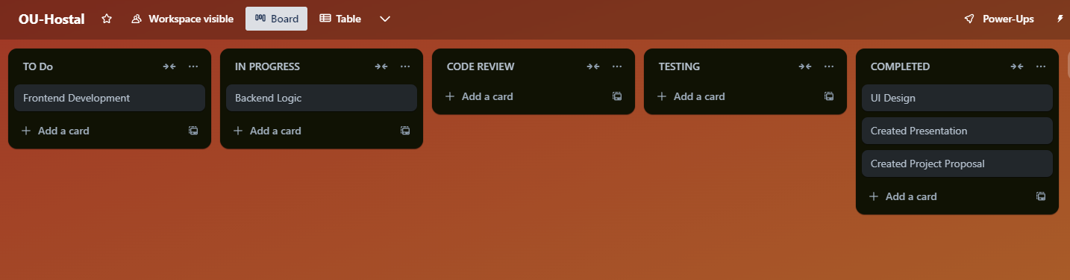
TRELLO BOARD SCREENSHOT
Trello Board Link : OU Hostel Project Planning

Slide 14
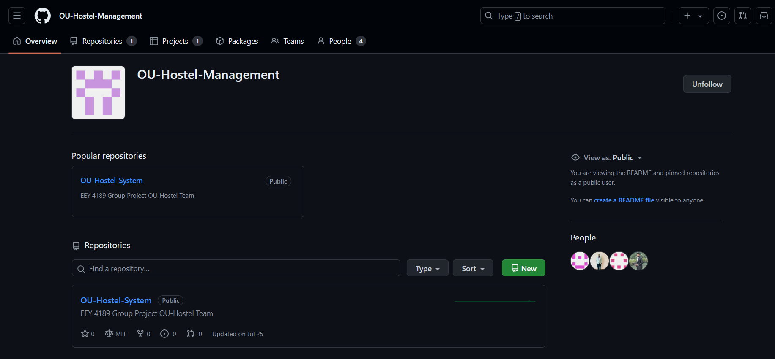
GIT
Github Repository Link : https://github.com/OU-Hostel-Management/OU-Hostel-System

Slide 15
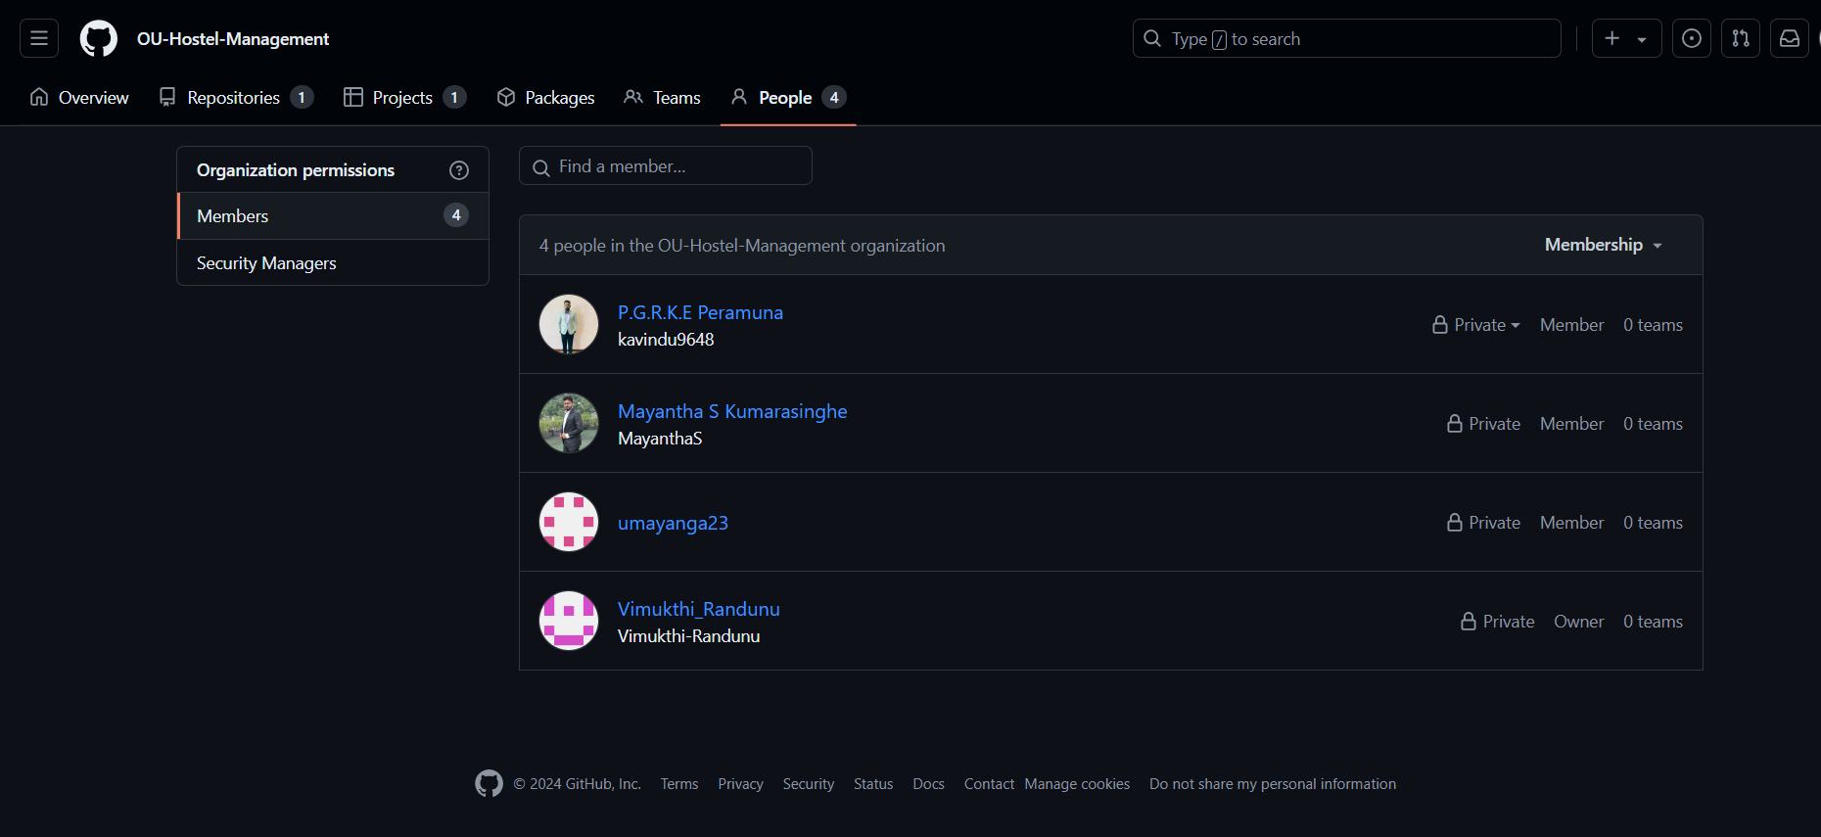

Slide 16
Monthly Retrospective
Overview : During the past month, our project made significant strides in setting up the foundation for development and designing the user interface.
Key Activities and Achievements : GitHub Project Setup : Created a GitHub project repository and added all team members to ensure
seamless collaboration and version control : UI Design Completion : Successfully designed the user interface for the application, focusing on user-friendliness and responsiveness. This included layouts for key features such as room
Booking, user profiles, and admin dashboards : Collaboration and Workflow : Established an efficient workflow using GitHub, enabling effective task management and progress tracking.

Slide 17
Project Limitations and Problems Encountered
Limitations :-
Complex Integration : We faced significant challenges in connecting the UI with the backend components. The complexity in creating clear and seamless logic between the user interface and backend systems slowed down our progress.

Slide 18
Project Timeline and Conclusion
June
Project Proposal Submission
June
Progress Report/Presentation Submission
August
Progress Review Presentation
November
Progress Review Presentation
November
Final Presentation

Slide 19
THANK YOU
Approved for Submission
………………………………………………….
Signature

